Slide 1
SOLAR FORECASTING
GROUP 33
ABHIMANYU SINGH BISHT 2001CB04
KHUSHI SHAH 2001EE91
SYED IBRAHIM AHMAD 2001ME77
ANSHUL THAKKAR 2001EE86
SAI NANDAN PANIGRAHY 2001CB46
SYED SHAHEER TANVEER 2001CB58

Slide 2
Recap

Slide 3
Our work so far….
The goal of this project is to discover which statistical and machine learning techniques provide the best short term predictions of solar energy production.
Since we didn’t get a dataset, we went through a long and tedious process of finding it.
We worked on the data in steps-
Preprocessing and Cleaning
Data Visualisation and Statistics
Statistical Analysis
Hypothesis Testing

Slide 4
Understanding The Dataset
The first dimension is the date of the model run and will correspond directly with a row in the train.csv file.
The second dimension is the ensemble member that the forecast comes from.
The third dimension is the forecast hour, which runs from 12 to 24 hours in 3 hour increments.
The fourth and fifth dimensions are the latitude and longitude uniform spatial grid.

Slide 5
TABLE
Variable | Description | Units
tmin_2m | Mininmum Temperature over the past 3 hours at 2 m above the ground | K
tmp_2m | Current temperature at 2 m above the ground | K
tmp_sfc | Temperature of the surface | K
ulwrf_sfc | Upward long-wave radiation at the surface | W m-2
ulwrf_tatm | Upward long-wave radiation at the top of the atmosphere | W m-2
uswrf_sfc | Upward short-wave radiation at the surface | W m-2
tmax_2m | Maximum Temperature over the past 3 hours at 2 m above the ground | K
tcolc_eatm | Total column-integrated condensate over the entire atmos. | kg m-2
Variable | Description | Units
apcp_sfc | 3-Hour accumulated precipitation at the surface | kg m-2
dlwrf_sfc | Downward long-wave radiative flux average at the surface | W m-2
dswrf_sfc | Downward short-wave radiative flux average at the surface | W m-2
pres_msl | Air pressure at mean sea level | Pa
pwat_eatm | Precipitable Water over the entire depth of the atmosphere | kg m-2
spfh_2m | Specific Humidity at 2 m above ground | kg kg-1
tcdc_eatm | Total cloud cover over the entire depth of the atmosphere | %

Slide 6
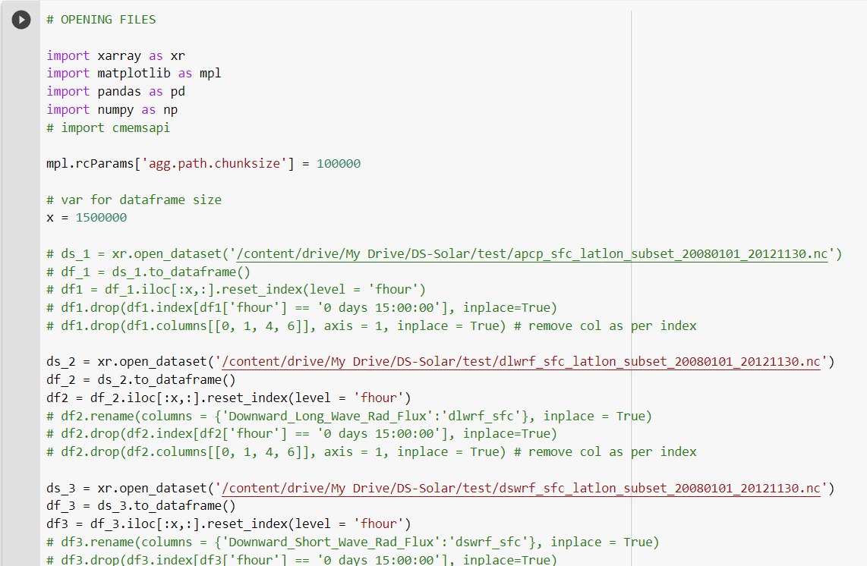
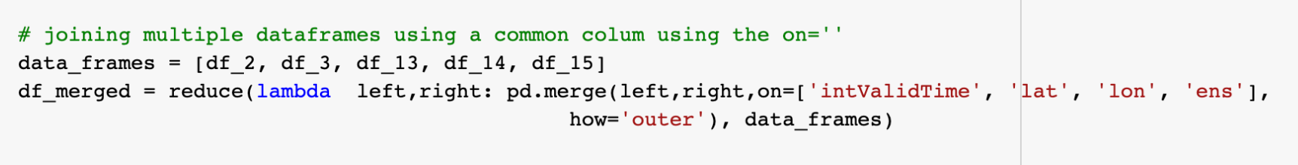
Preprocessing -
Notes:
So as we saw time, the data we had was in .nc format which wasnt supported by standard libraries. After various attempts, we used the xarray library at last which converted the data into pandas. We also went on to create new features out of existing features.

Slide 7
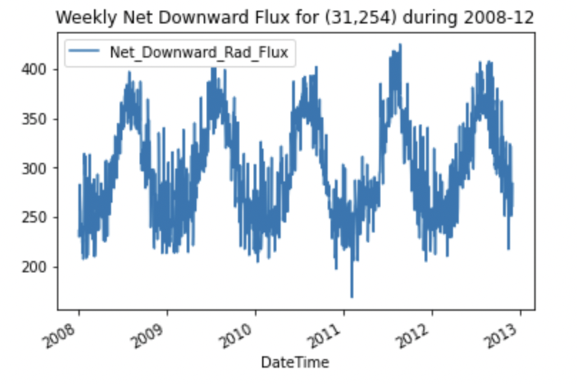
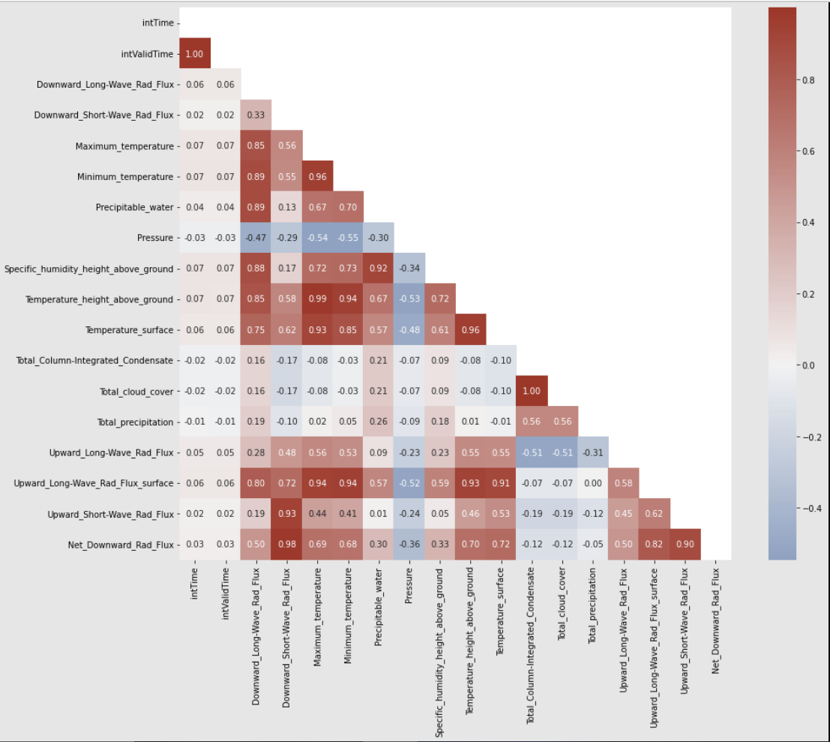
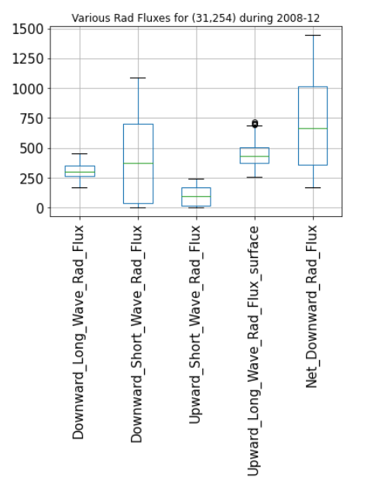
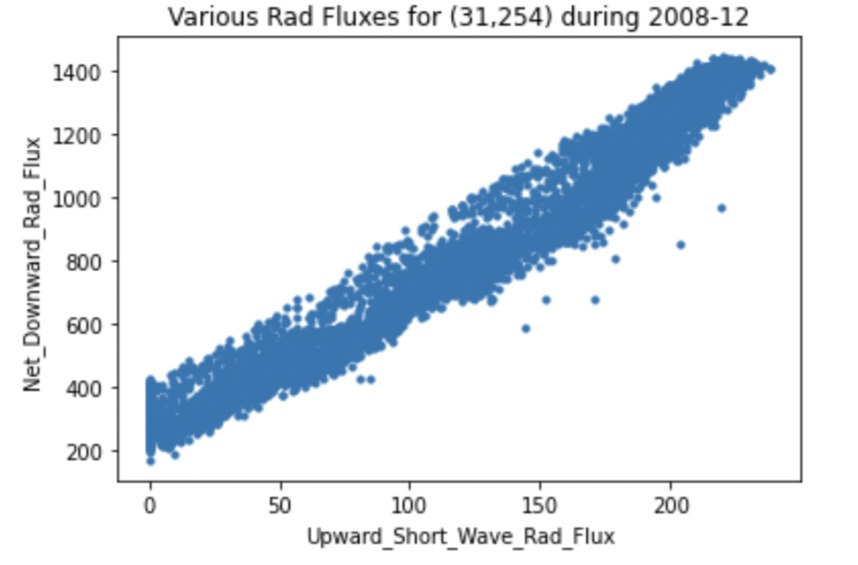
Visualization Plots:
Notes:
Here we have 4 plots that we constructed using the data we had.

Slide 8
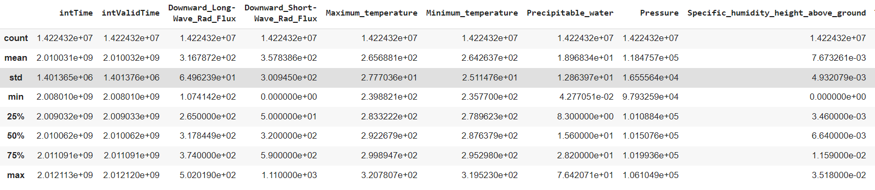
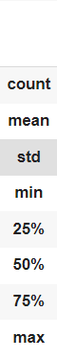
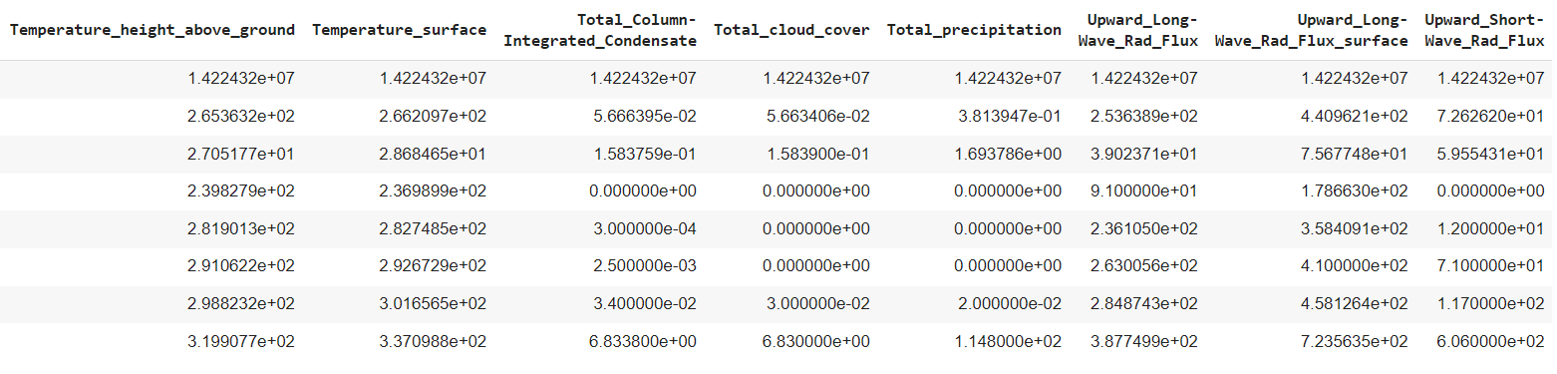
A Brief Statistical Summary:

Slide 9
Hypothesis Testing

Slide 10
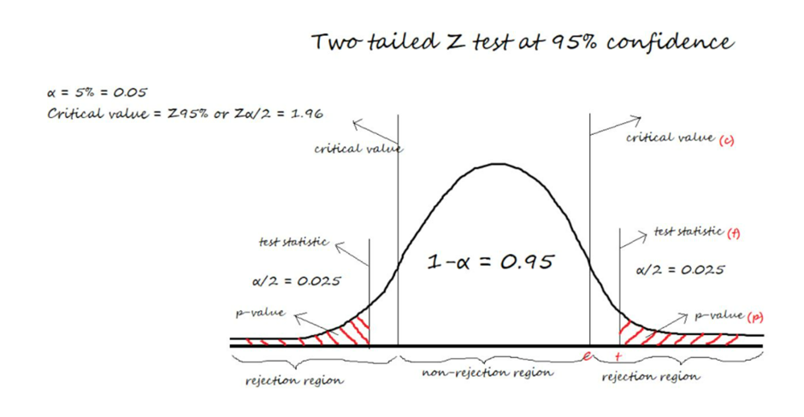
Null Hypothesis
We propose that if we take a sample of 150 readings from a random location (31, 259), the mean of that particular sample doesn’t deviate from the mean of the total training data with respect to our chosen confidence interval.
In our case, we take the significance value cut-off (alpha) to be 0.05 (or 5%).

Slide 11
Machine Learning

Slide 12
Machine Learning Models
Used
MLR
SVR
Random Forest
Decision Tree
Notes:
Multiple linear regression
Support vector regression
Random forest
Extreme Gradient Boosted Decision Trees
The models will be explained in detail in the coming slides

Slide 13
Implementing the Models
Before we explain each model that we have used to make predictions, There were a few steps that were common while utilising all of them:
According to the model being used, our data set was preprocessed respectively.
We split our data into a Training set and Testing Set. (Training being 80% of the data and the rest 20% being the testing set)
The Predictions made by the models were evaluated using RMSE and R-squared evaluation metric. The Evaluation metrics have been explained ahead.
Notes:
We processed the data before applying the models, selecting and sorting the data as per location and ensemble, we added a new DateTime column and rearranged it to make it the first column so that we can easily split the data using column numbers. We then removed all the columns containing metadata, and again sorted it using the newly created DateTime column and reset the index
Then we split the data with 80:20 ratio with the larger set forming the training data and the smaller set making the testing data. These sets were then used as inputs for the models and we compared the model performance using two metrics r2 score and rmse. These metrics have been explained in the coming slides

Slide 14
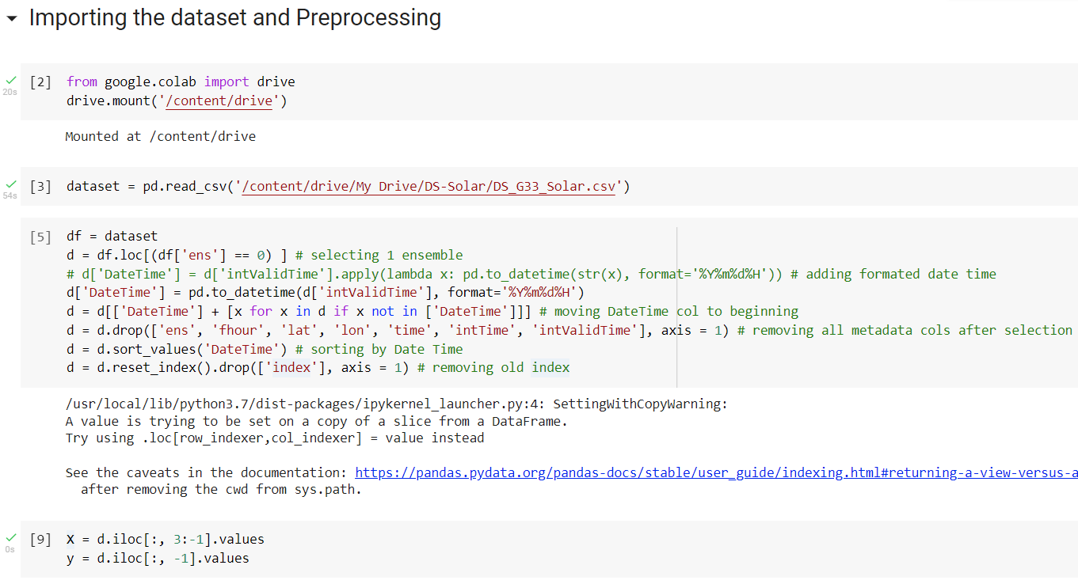
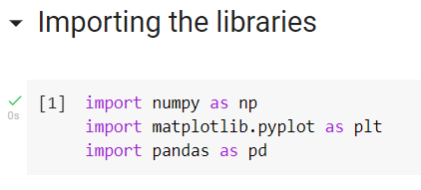
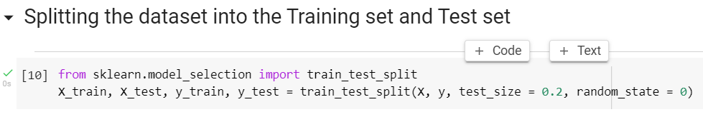
These three libraries were used in all the models.
Preprocessing being done before implementing the models.
Splitting the dataset.

Slide 15
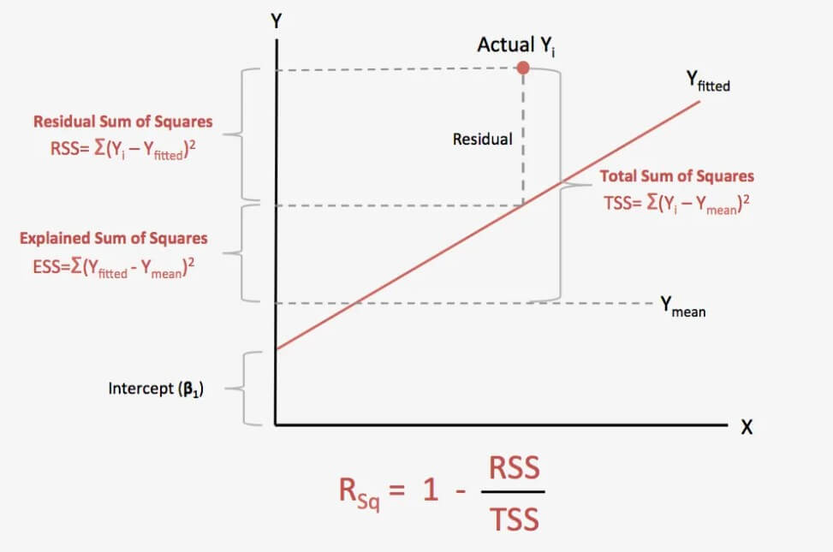
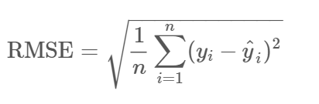
Model Evaluation Metrics
RMSE (Root Mean Squared Error)
R^2 (R squared)
As suggested by the name, It is the simple square root of mean squared error.
If the noise is small, as estimated by RMSE, our model is good at predicting our observed data, and if RMSE is large, this generally means our model is failing to account for important features underlying our data.
R-squared evaluates the scatter of data points around the fitted regression line.
For a Data set, higher R-squared values represent smaller differences between observed data and fitted values.
Notes:
R2 squared is also known as Coefficient of Determination or sometimes also known as Goodness of fit.

Slide 16
Multiple Linear Regression

Slide 17

Introduction to MLR
Multiple linear regression (MLR) is a statistical technique that uses several explanatory variables to predict the outcome of a response variable. The goal of multiple linear regression is to model the linear relationship between the explanatory (independent) variables and response (dependent) variables.
In essence, multiple regression is the extension of ordinary least-squares (OLS) regression because it involves more than one independent variable.
Formula and calculation of MLR
Notes:
The goal of multiple linear regression is to model the linear relationship between the explanatory (independent) variables and response (dependent) variables.

Slide 18
Pros and Cons
Pros
Cons
It holds the ability to determine the relative influence of one or more predictor variables to the criterion value. This way, a Statistician can explore the effect of more than one variable on the outcome he wants to study.
The second advantage is the ability to identify outliers, or anomalies.
Many difficulties tend to arise when there are more than five independent variables in a multiple regression equation.
Regression models cannot work properly if the input data has errors

Slide 19
Using MLR in analysis of the problem
Out of the 16 independent variables that we had, we took 13 of them into consideration and and used MLR to predict the dependent variable (In our case, the net downward radiation flux).
This required us to import the scikit-learn Library.
Upon Evaluation of the model, we get:
RMSE = 90.95
R^2 = 0.924

Slide 20
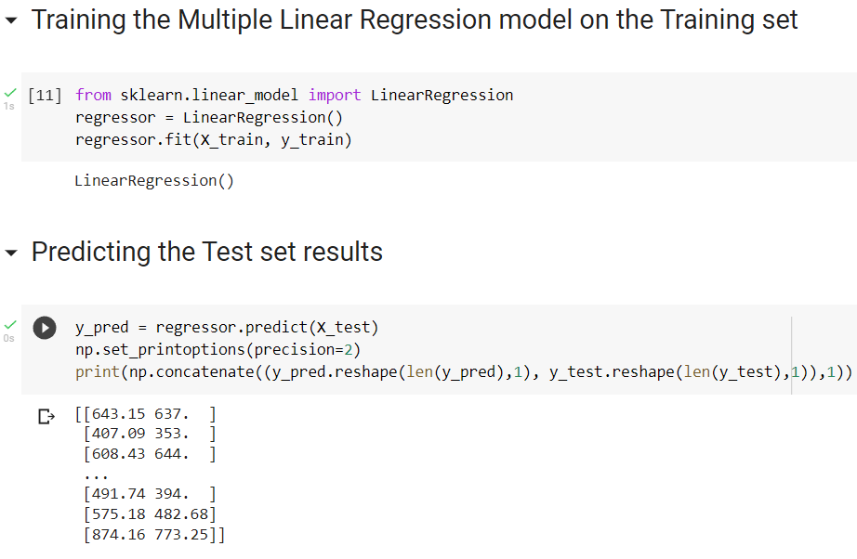

Slide 21
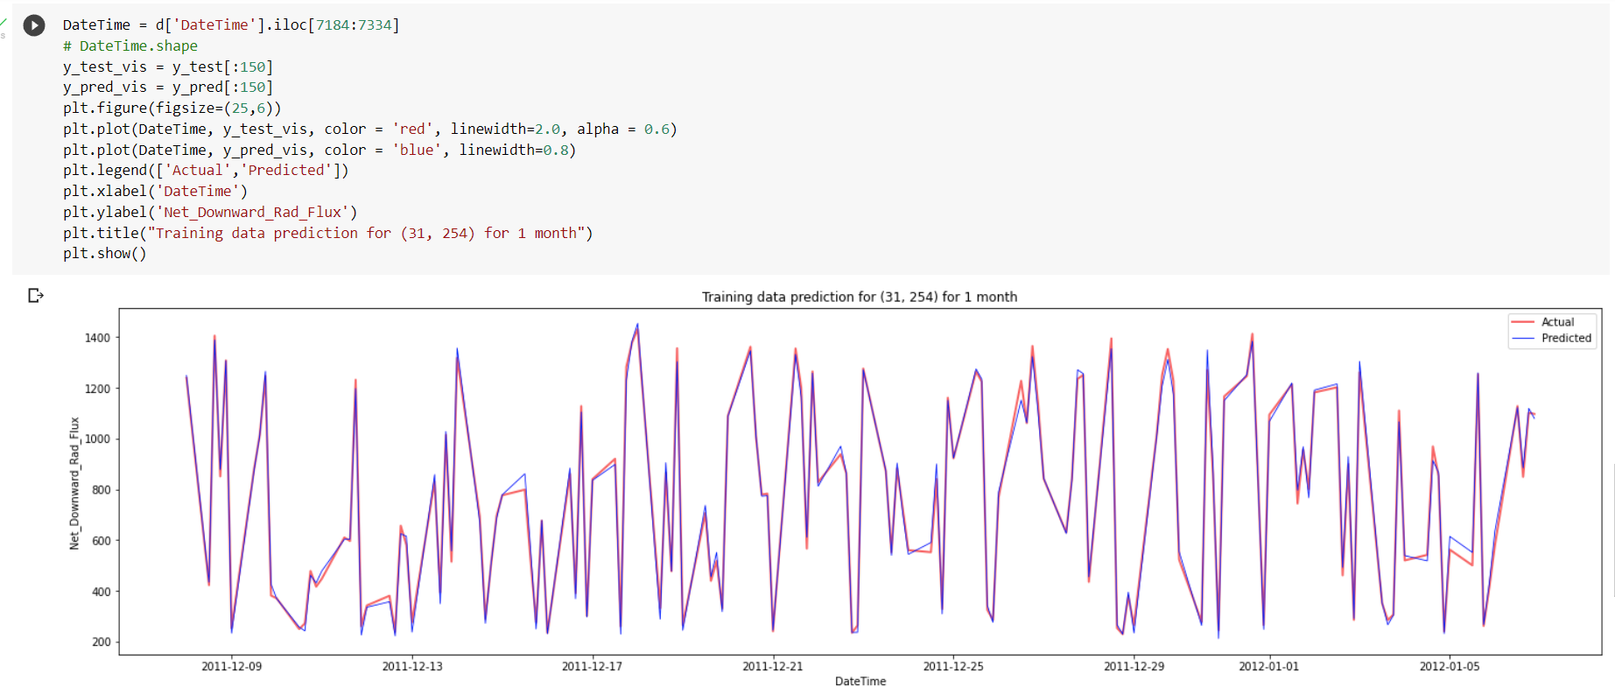
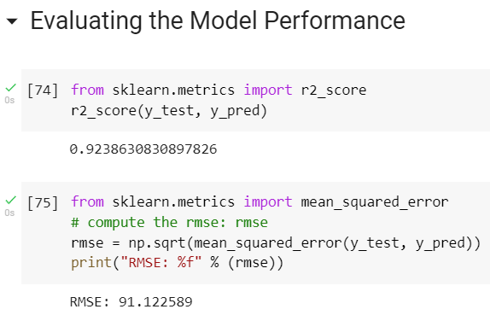
Plotting the predicted values and actual values on the same graph.
Evaluating the model performance using RMSE and R-squared metrics.

Slide 22
Support Vector Regression

Slide 23
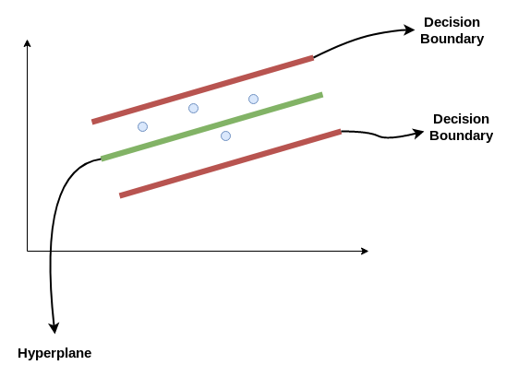
Introduction to SVR
Support Vector Regression follows the equation y=wx+b, the line is called a Hyperplane. The data points on either side of the hyperplane that are closest to it are called Support Vectors. They are used to plot the boundary line. The basic idea behind SVR is to find the best fit line.

Slide 24
Pros and Cons
Pros
Cons
SVR has L2 Regularization feature. So, it has good generalization capabilities which prevent it from over-fitting.
SVR can efficiently handle non linear data.
The SVR model is stable and a small change in data does not affect the hyperplane greatly.
Choosing an appropriate Kernel function (to handle the non-linear data) is not an easy task.
One must do feature scaling of variables before applying SVR.
SVR takes a long training time on large datasets.
Notes:
Choose one point from pros to be scraped off

Slide 25
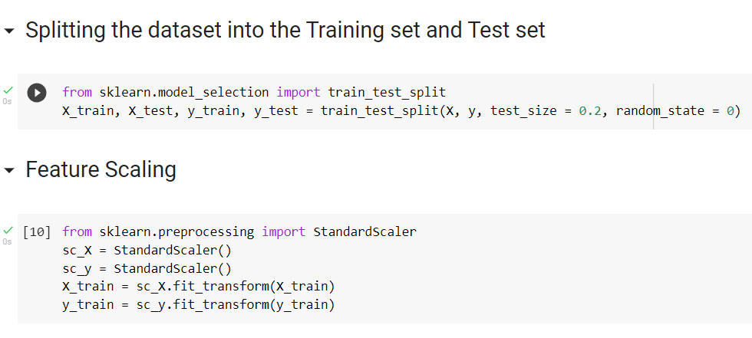
Code
While using SVR, Feature Scaling becomes necessary and we use StandardScaler() function of the sklearn library for this.
Notes:
After updating the Time and Date format and reshaping y, we finally begin working on implementing the model.

Slide 26
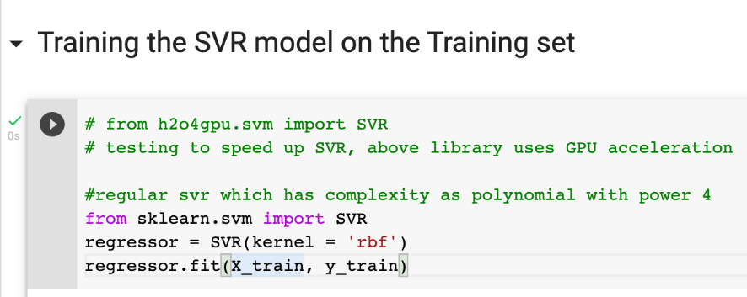
Code
For training the SVR model on the dataset, we use SVR function of sklearn library. For this purpose we use a special kernel= “rbf”
RBF(Radial Basis Function) is one of the most widely used kernels owing to its similarity to Gaussian Distribution. The RBF kernel function for two points X₁ and X₂ computes the similarity or how close they are to each other.
Notes:
The next step after feature scaling is Training the model. We use the SVR function of sklearn library for this. We also use a special kernel = “RBF” for training the model on the non linear dataset. Radial Basis Function, abbreviated as RBF, is one of the most widely used kernels owing to its similarity to Gaussian Distribution. The RBF kernel function for two points X₁ and X₂ computes the similarity or how close they are to each other.

Slide 27
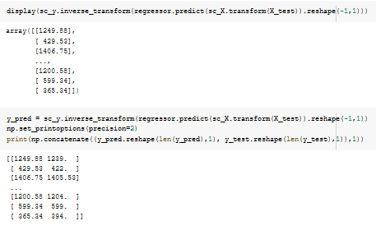
Code
Notes:
Coming to the most interesting part of the code- predicting the test results. We first scale X and then use the predict function belonging to the regressor class in sklearn. Further making use of inverse_transform function to scale back to the original values ( that had been scaled by StandardScale() ) Once again, we reshape the predicted values of y as we get the transpose of it from the inverse transform function.

Slide 28
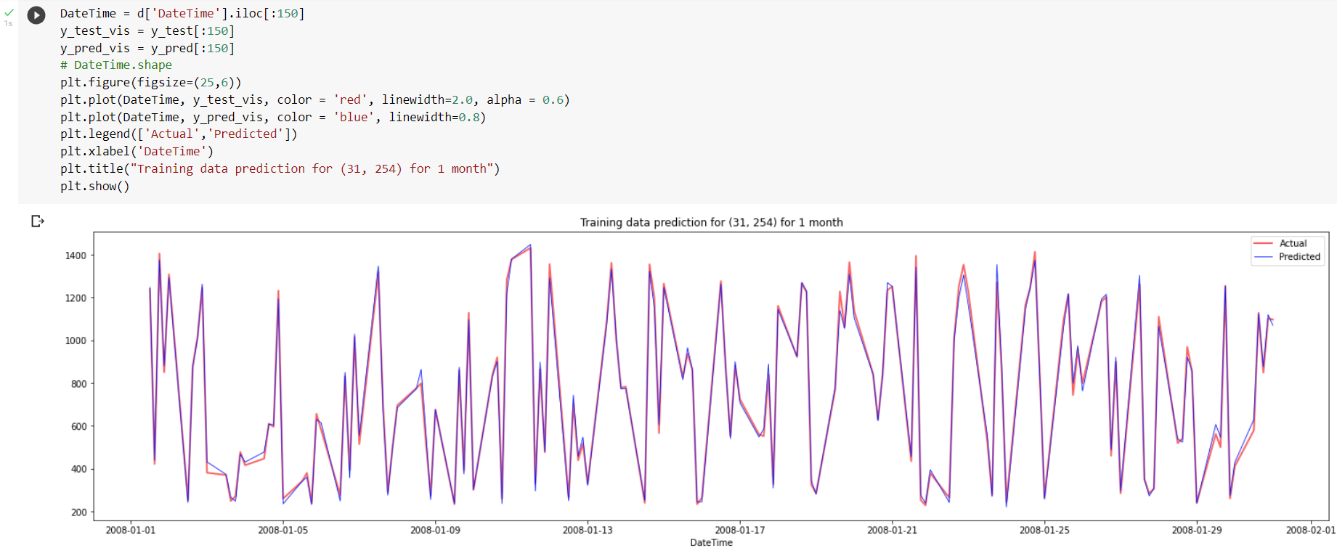
Results
Despite the long run time, SVR model gave an incredible r2 score of 0.931.
It’s RMSE score was 87.73.
Predicted vs Actual values
Notes:
Post prediction, we try evaluating the model by two parameters- r2 score and rmse score. The SVR model on our dataset gave an r2score of 0.931 and an rmse score of 87.73. We have also plotted a graph showing comparison between the predicted values and the actual values. Now we shall proceed to Random Forest Model.

Slide 29
Random Forest

Slide 30
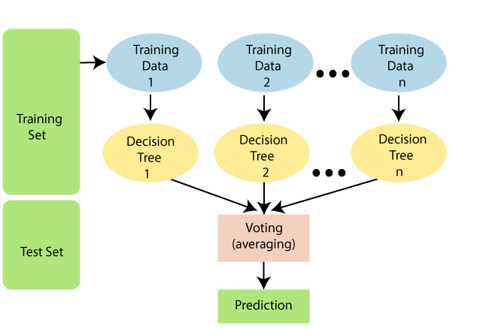
Introduction
Random Forest is a popular supervised learning algorithm that is used in both Regression and Classification.
Random Forest works in two-phase first is to create the random forest by combining N decision tree, and second is to make predictions for each tree created in the first phase.

Slide 31
Pros and Cons
Pros
Cons
Generally, the accuracy for Random Forest Algorithm is high.
It has high efficiency in large dataset.
Generated Forests can be saved and reused.
Random Forest has measures that prevent overfitting.
A forest is less interpretable than a single decision tree. Single trees may be visualized as a sequence of decisions.
A trained forest may require significant memory for storage, due to the need for retaining the information from several hundred individual trees.

Slide 32
Problem Analysis
Random forest algorithms have three main hyperparameters, which need to be set before training. These include node size, the number of trees - 50, and the number of features sampled - 13. From there, the random forest classifier can be used to solve for regression or classification problems.
Since our dataset is large, Random Forest Algorithm seems suitable for predicting the Net Downward Flux due to high efficiency and high accuracy.

Slide 33
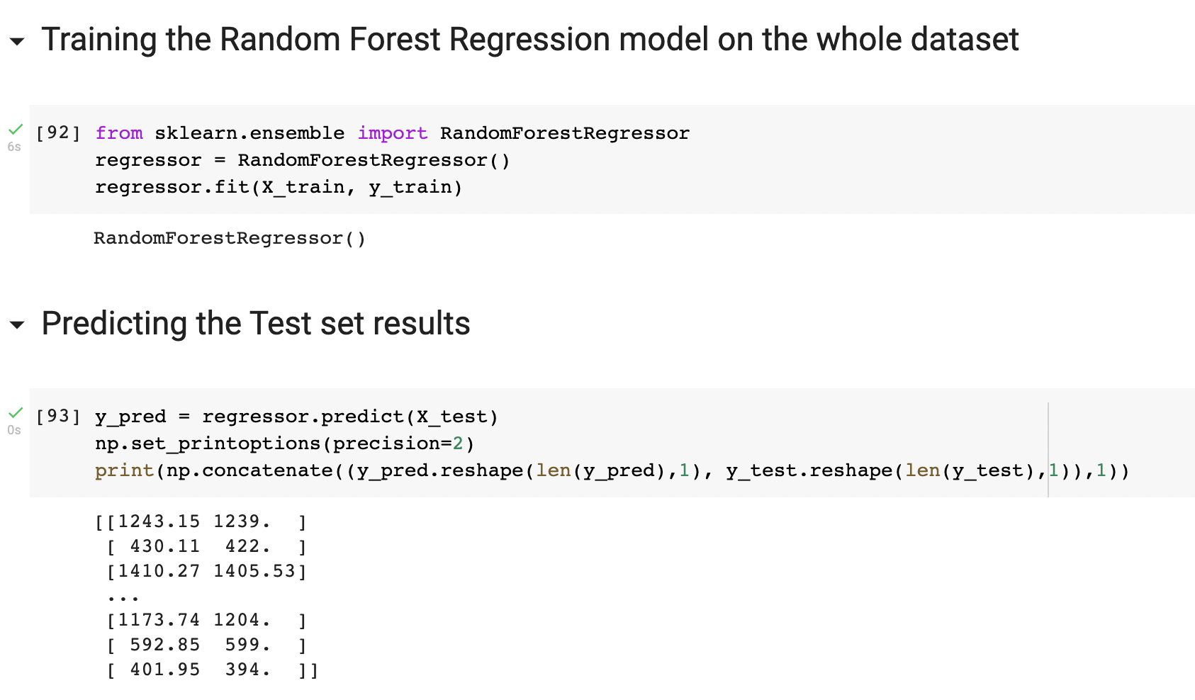
Code
We imported the RandomForestRegressor function from sklearn library.
We set the number of trees we want to use as 50 using n_estimators, and went on to train the model on the dataset.
Next, we predicted the test set results and juxtaposed the predicted values alongside the actual values to see the comparison clearly.

Slide 34
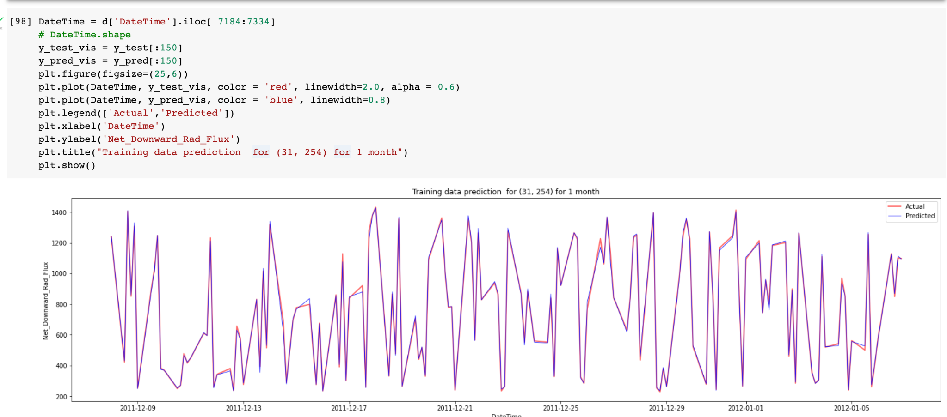
Plotting the Graph

Slide 35
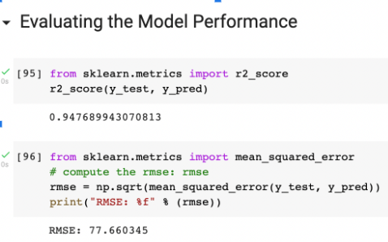
Results
The random forest regression model gave us a really good r2 score of 0.948 and RMSE value of 77.66, proving to be highly accurate and reliable.

Slide 36
XGBoosted Decision Tree
Notes:
Now we come to the section of xgboosted decision trees. NEXT SLIDE PLEASE

Slide 37
Introduction
XGBoost: Extreme Gradient Boosting or XGBoost is a machine learning algorithm where several optimization techniques are combined to get perfect results within a short span of time.
Overfitting is avoided with the help of regularization and missing data is handled perfectly well along with cross-validation of facts and figures.
XGBoost specifically trains the gradient boost data and gradient boosted decision trees.
Notes:
Extreme Gradient Boosting, also known as xgboost, is an ML algorithm which can be used to specifically train gradient boosted decision trees to get perfect results within a short span of time. It also helps to prevent overfitting of data and handles missing data quite well. But let us first see what we actually mean by overfitting.

Slide 38
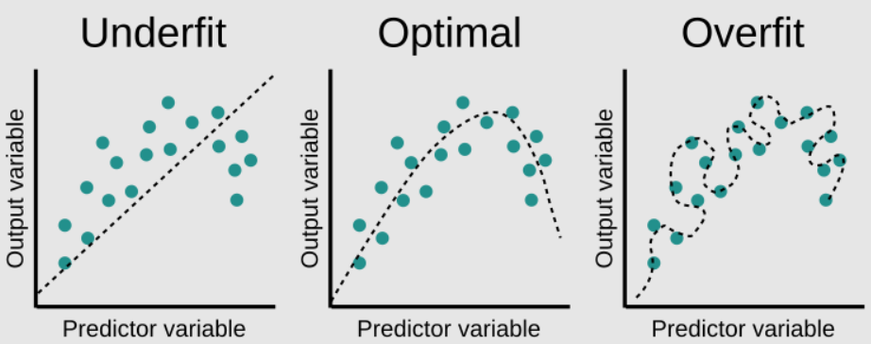
Understanding Overfitting
Notes:
Here we have the same collection of data point plotted in 3 different graphs. The first model on the left predicted the output variable using a straight line which led to many points lying way to far from the line. The third one fits too just many data points and may not be a good fit for predicting other input data. The one on the middle is the best fit for the current scenario.

Slide 39
The idea of gradient boost
Gradient boosting is a machine learning technique used in regression and classification tasks, among others. It gives a prediction model in the form of an ensemble of weak prediction models
The idea of boosting came out of the idea of whether a weak learner (weak learners are models that perform slightly better than random guessing. Strong learners are models that have arbitrarily good accuracy) can be modified to become better.
When a decision tree is the weak learner, the resulting algorithm is called gradient-boosted trees
Notes:
So we now try to understand the idea behind gradient boosting. The idea of boosting came out of the idea of whether a weak learner can be modified to become better. And when a decision tree is the weak learner, the resulting algorithm is called gradient boosted trees.

Slide 40
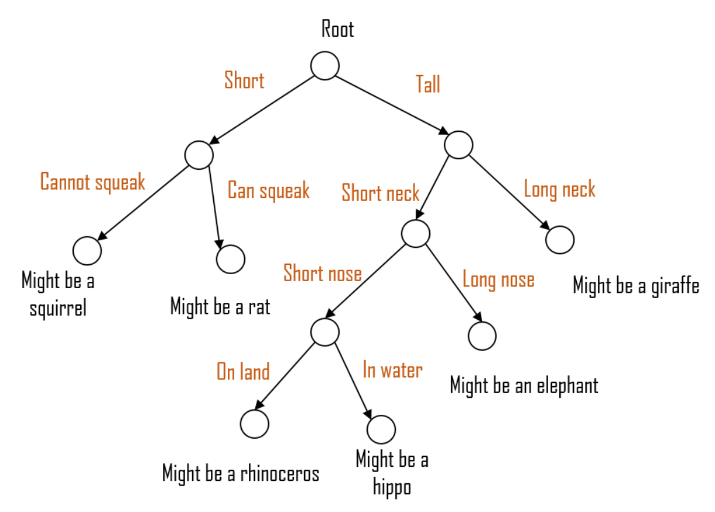
Decision Tree
Decision Tree : A Decision tree is a flowchart like tree structure, where each internal node denotes a test on an attribute, each branch represents an outcome of the test, and each leaf node (terminal node) holds a class label.
To reach the leaf, the sample is propagated through nodes, starting at the root node. A decision is made based on the selected sample’s feature. It is usually one feature used to make the decision (one feature is used in the node to make a decision). Decision tree learning is a process of finding the optimal rules in each internal tree node according to the selected metric.
Notes:
Coming to decision trees, they are nothing but flowchart like tree structures, where each internal node denotes a test on an attribute, each branch represents an outcome of the test, and each leaf node (ie, terminal node) holds a class label. Decision tree learning is a process of finding the optimal rules in each internal tree node according to the selected metric.

Slide 41
Pros and Cons
Pros
Cons
Less feature engineering required (No need for scaling, normalizing data, can also handle missing values well)
Has quite good execution speed
It is very less prone to overfitting
It doesn’t work so well on sparse data, though, and very dispersed data can create issues
Tweaking or improper tuning of parameters, when the trees are too deep, can cause overfitting
Difficult to interpret as the visualization is tough
Notes:
These are some of the pros and cons of XGBoost. One of the major pros of using XGboost is that it has very good execution speed. But on the other hand, it doesn’t work on sparse data and very dispersed data can cause issues.

Slide 42
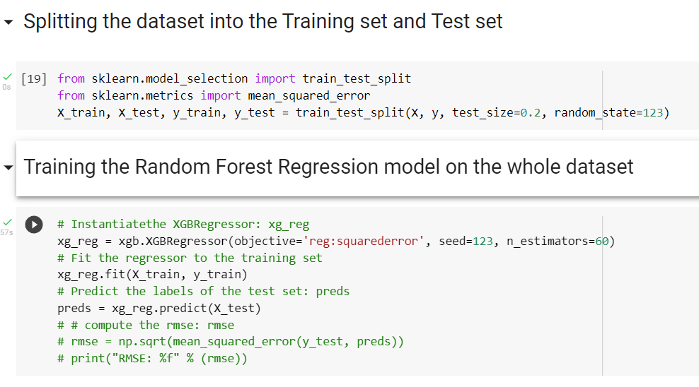
Training set and Test set
Notes:
This is the code where we split the dataset into training and test set. We then use XGboost to train our model.

Slide 43
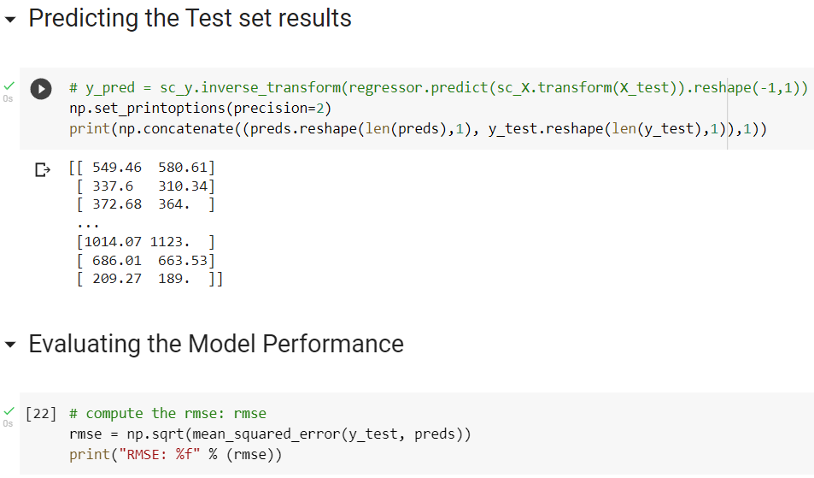
Results
Notes:
We then predict the values and display the test set results. We also evaluate the model’s performance. The Root mean square error comes out to be 21.39 and the r squared score comes out to be 0.996.

Slide 44
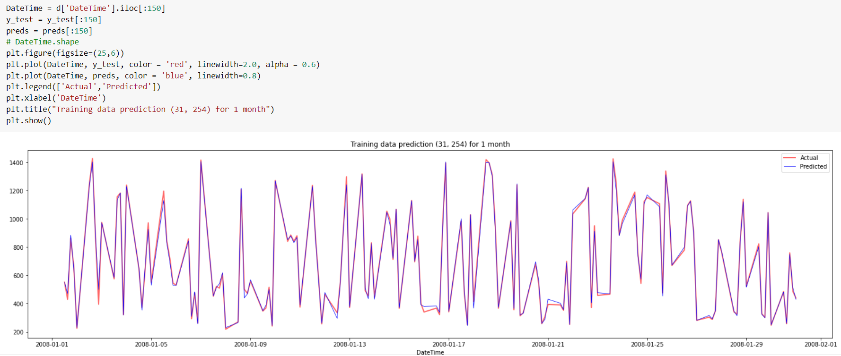
Results
Notes:
This is the plot of predicted values and the actual values of one location for one month. As it can be seen, the predicted values are quite close to the actual values.
Now over to Ibrahim for the conclusion and final result.

Slide 45
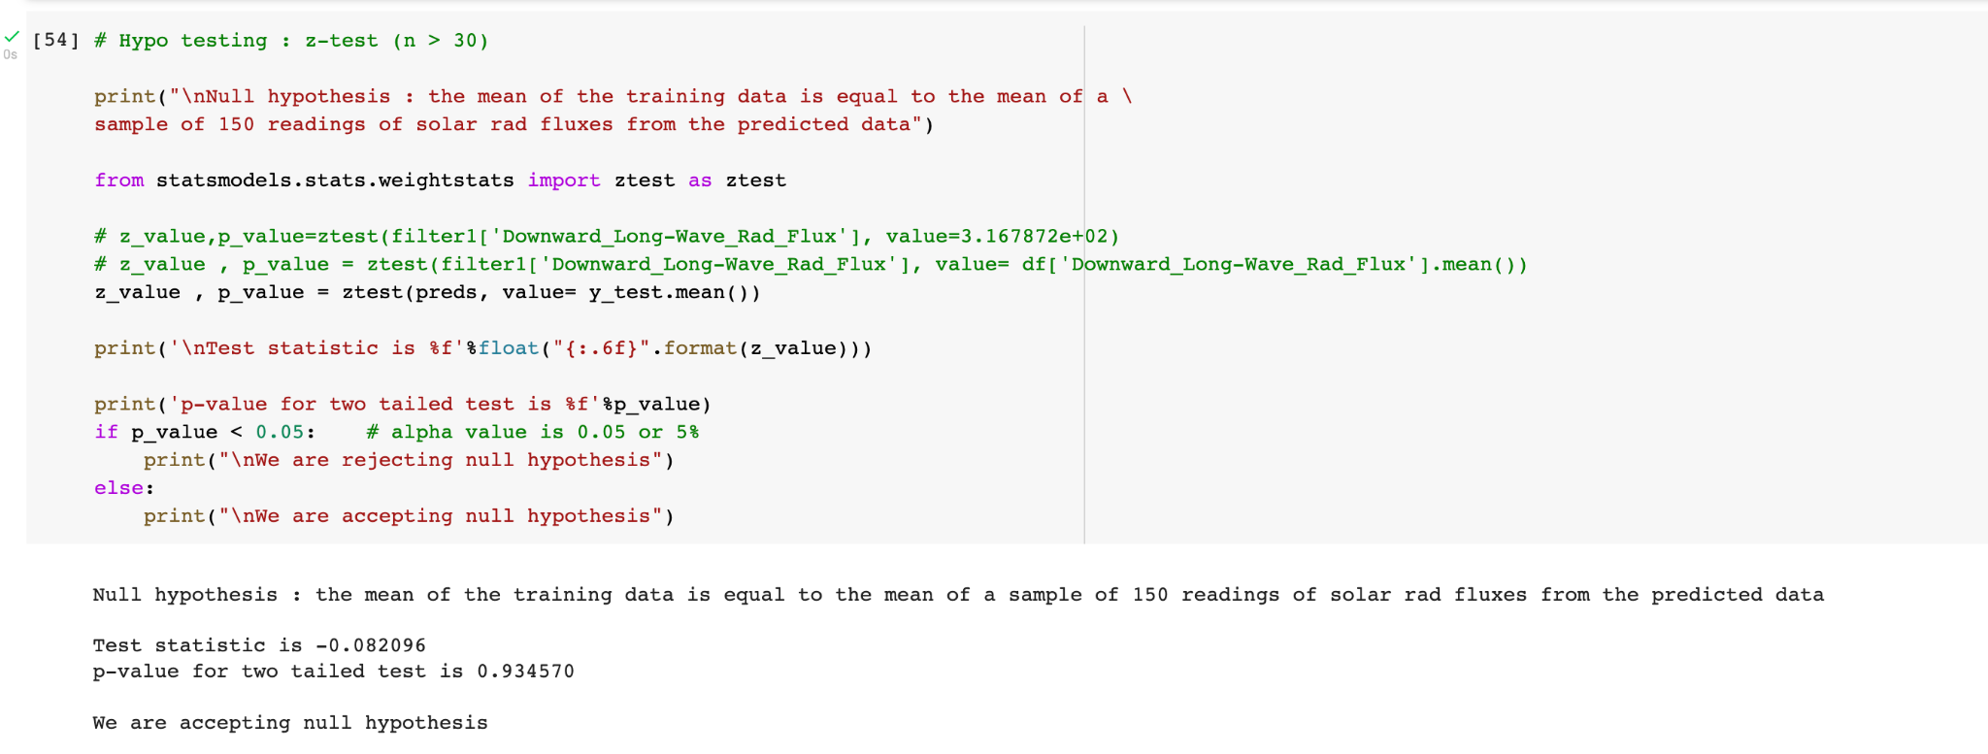
Conclusion
Notes:
Here our null hypothesis considers our best model’s i.e XGBoost efficiency/performance. So the metric that we are using for this is z-test on the trending mean of the training data as well as a sample of 150 readings of the predicted data.
We see that our Null hypothesis can be accepted with a confidence level of 95%

Slide 46
Evaluation of the Models :
Decision Tree
Random Forest
SVR
MLR
R^2 score: 0.997
RMSE: 21.39
R^2 score: 0.948
RMSE: 77.66
R^2 score: 0.931
RMSE: 87.72
R^2 score: 0.924
RMSE: 90.95
The chosen performance metrics for all the models are quite close and we can see XGBoosted Decision trees outperforms the other three. However their relative values are good, which means all of them are giving reasonably good predictions.

Slide 47
Thank You!

